Slide 1
IPSec Redundancy solution in AWS
Problem and Solutions
September 2019

Slide 2
Problem Statement
Design Principles/Considerations
Failover Factors
Failover Mechanism
Demo
Implementation

Slide 3


Problem Statement: Redundancy in public cloud
vSRX Traditional HA solution using L2
IPsec redundancy with dual vSRX is one of the critical customer requirements.
Existing Chassis Cluster/ High Availability solutions rely on L2 layer for session-sync and data failover
works well in on-prem scenarios where Network is under admin-control
Public clouds such as AWS, Azure, etc. do not support L2 traffic or Multicast
Traditional methods of session sync will not work in public cloud environments

Slide 4
Design Principles/ considerations
Offer Reliability
Tunnels redundancy
Firewall nodes redundancy
Availability Zones/Geo-redundancy
High Availability Networking:
multiple VPN connections from on-prem to the cloud
Dead-Peer-Detection and Routing ➔ Heathy Path
Leverage AWS services
CloudWatch for health-check
Lambda/Server-less compute for VPC internal route change
Does not need any new effort from Engineering
Cost effective
Lambda is free for first 1 million calls per month. It is unlikely our customers will need anything like 1 million calls in a month anyhow for this solution.
Cloudwatch metrics can be as low as $21 per month for 10,000 metrics.

Slide 5
Failover Factors
Instance Status: Stopping, pending, shutting down
CloudWatch metrics
vSRX CPU utilization
Interface Input and Output PPS
And other metrics…

Slide 6
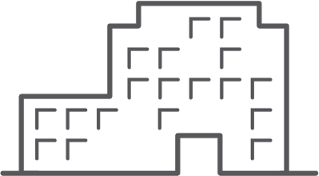







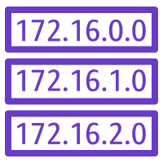

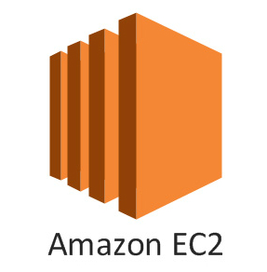
Failover Mechanism
On-prem SRX
1. Redundant IPSec Tunnels between On-prem Gateway and 2 vSRX instances in AWS.
Primary tunnel (higher preference) in Use: Route between EC2 and On-prem workloads through vSRX1 and On-prem SRX
Primary
Secondary
CloudWatch
Availability Zone 1
Availability Zone 2
vSRX1
vSRX2
Lambda
2. EC2 instance maintains route to the AWS VPC Router. Route to vSRX1 in Route Table.
VPC Router (Route Table)
Application Workload

Slide 7
Failover Mechanism
On-prem SRX
Primary
Secondary
3. vSRX1 is disabled. e.g. state = “stopping”
CloudWatch
4. CloudWatch notifies Lambda.
Availability Zone 1
Availability Zone 2
vSRX1
vSRX2
Lambda
VPC Router (Route Table)
5. Lambda triggers the route change in VPC route table.
Application Workload

Slide 8
Failover Mechanism
On-prem SRX
7. On-prem GW detects the tunnel down event using Dead Peer Detection or Routing protocol updates. Switches to Secondary Tunnel to carry traffic
Primary
Secondary
CloudWatch
Availability Zone 1
Availability Zone 2
vSRX1
vSRX2
Lambda
VPC Router (Route Table)
6. New route points to vSRX2. Traffic is routed to vSRX2 from the Application Workload
Application Workload

Slide 9
DEMO
Video: https://drive.google.com/open?id=1w8zJaqAa-b_mqv4CNXRkK8JT-uKlbs6d
Lamda Script & vSRX config: http://git-hk.jnpr.net/jackytsui/aws-vsrx-ipsec-ha
Topology: next slide

Slide 10
demoVPC: 192.168.0.0/16
VM1
192.168.30.x/24
AWS Route Table
ge-0/0/1: 192.168.12.x/24
ge-0/0/1: 192.168.22.x/24
vsrx1
vsrx2
ge-0/0/0: 192.168.11.x/24
st0.0: 10.1.1.1/24
ge-0/0/0: 192.168.21.x/24
st0.0: 10.2.2.1/24
st0.0: 10.1.1.254/24 st0.1: 10.2.2.254/24
ge-0/0/0: 192.167.101.x/24
onPrem: 192.167.0.0/16
vsrx0
ge-0/0/1: 192.167.102.x/24
VM0
192.167.102.x/24

Slide 11
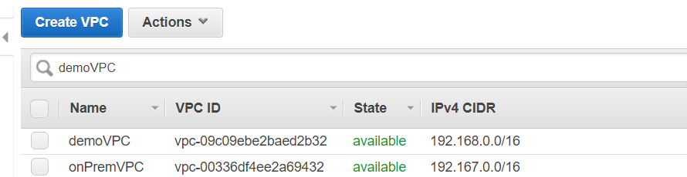
Implementation
1. Create VPCs. onPremVPC simulates On-prem lab.

Slide 12
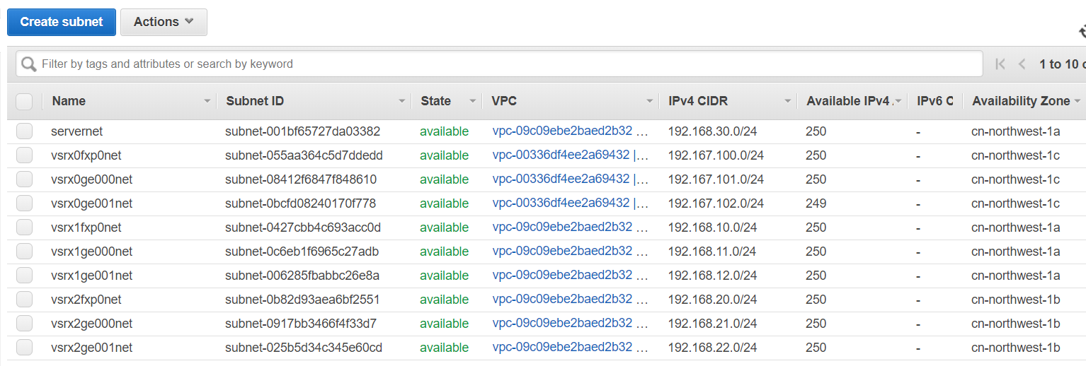
Implementation (cont)
2. Create Subnets.

Slide 13
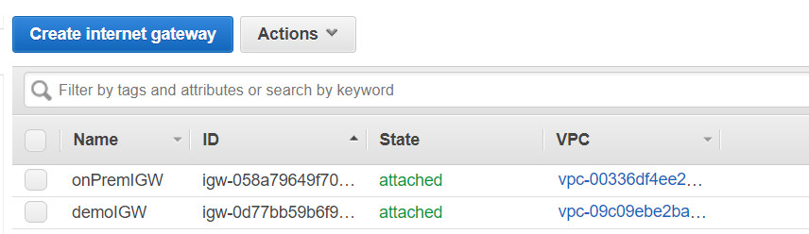
Implementation (cont)
3. Create Internet Gateways.

Slide 14
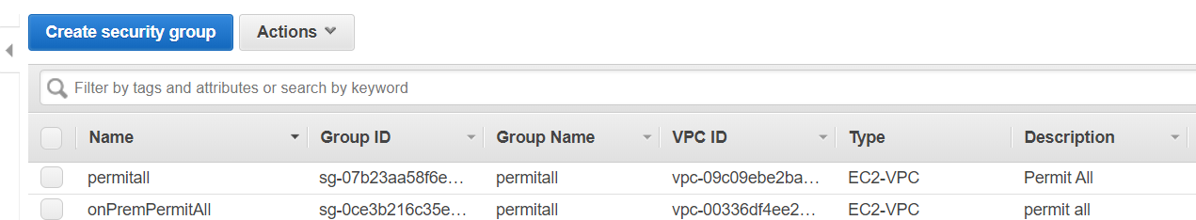
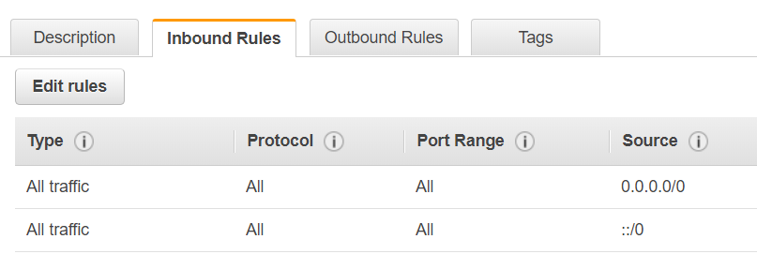
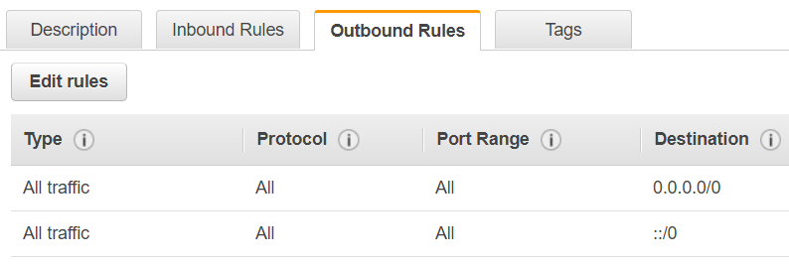
Implementation (cont)
4. Create Security Group.

Slide 15
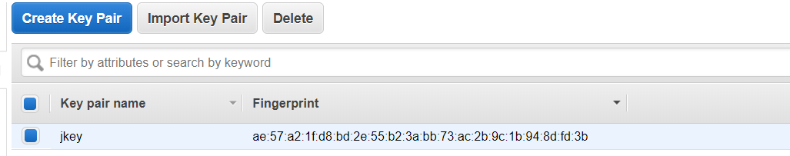
Implementation (cont)
5. Create Key Pair.

Slide 16
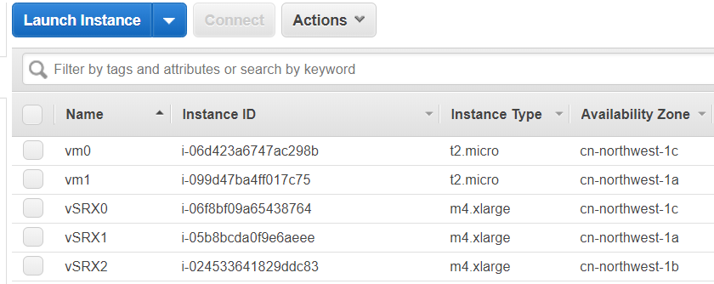
Implementation (cont)
6. Launch Instances.

Slide 17
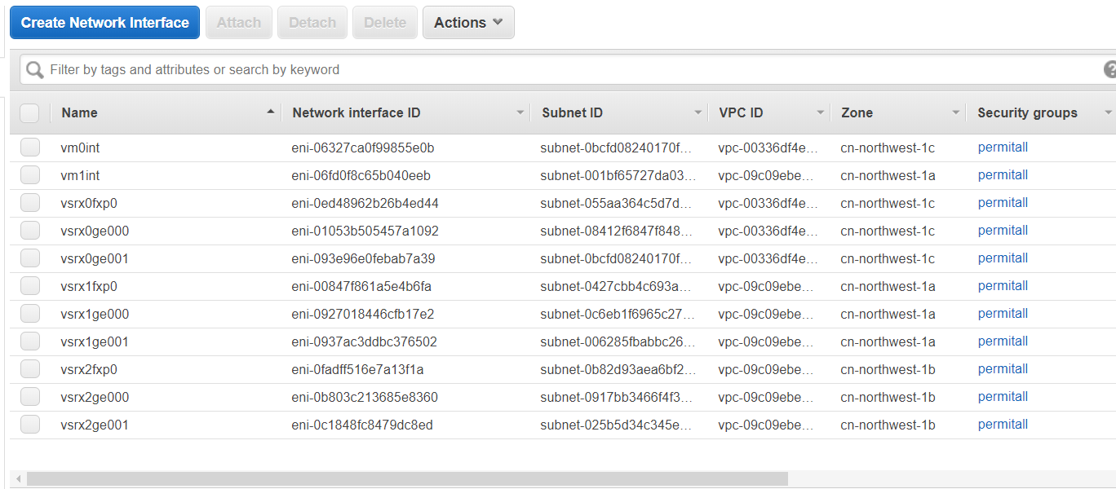
Implementation (cont)
7. Add Network Interfaces. Disable src/dest check in ge-interfaces.

Slide 18
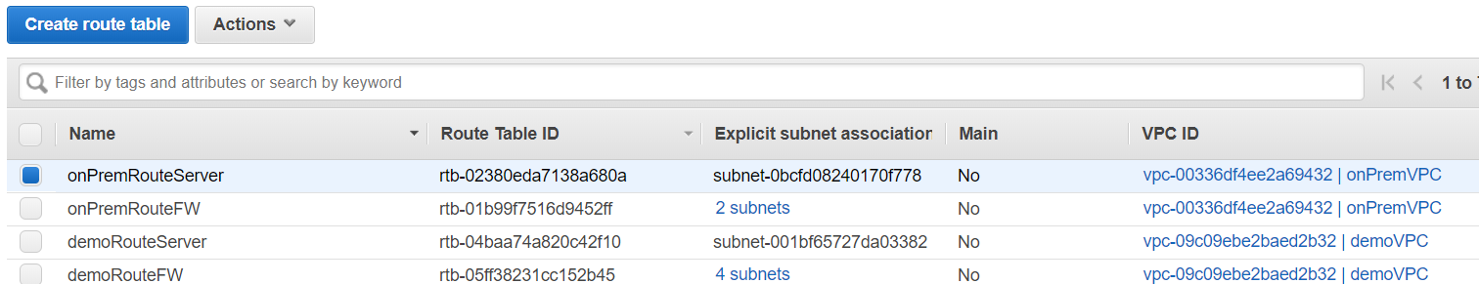
Implementation (cont)
8. Create Route Tables.
Route Table | Route | Subnet Associations
onPremRouteServer | 0.0.0.0/0 ➔ igw 192.168.30.0/24 ➔ vsrx0ge001 | 192.167.102.0/24
onPremRouteFW | 0.0.0.0/0 ➔ igw | 192.167.100.0/24, 192.167.101.0/24
demoRouteServer | 192.168.30.0/24 ➔ vsrx1ge001 | 192.168.30.0/24
demoRouteFW | 0.0.0.0/0 ➔ igw | 192.168.10.0/24, 192.168.11.0/24, 192.168.20.0/24, 192.168.21.0/24

Slide 19
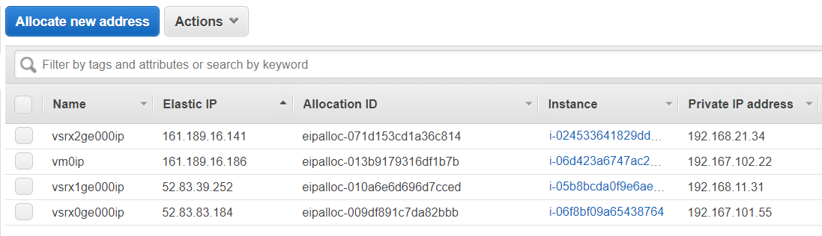
Implementation (cont)
9. Assign Elastic IP to fxp0 of vSRXs. Use the IPs to access vSRXs for configuration.
http://git-hk.jnpr.net/jackytsui/aws-vsrx-ipsec-ha/tree/master/vSRXconfig
10. Change the associations of the Elastic IP to ge-0/0/0.

Slide 20
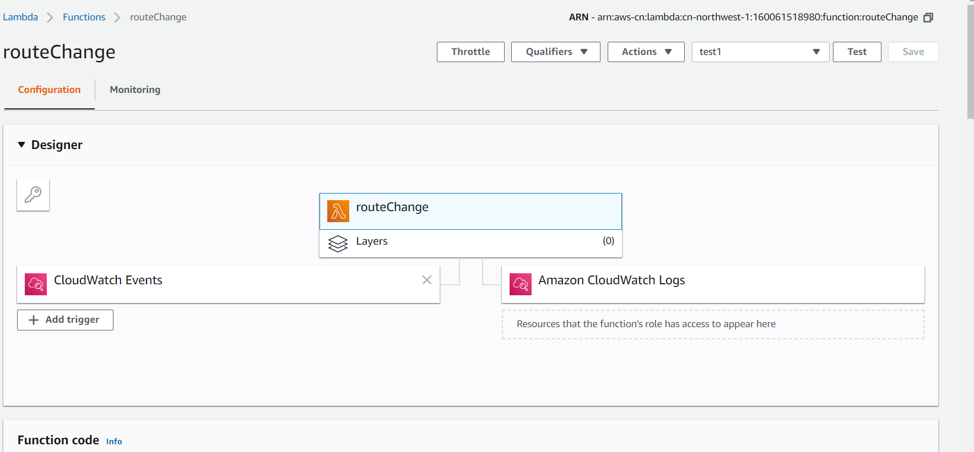
Implementation (cont)
11. Create Lambda function:
http://git-hk.jnpr.net/jackytsui/aws-vsrx-ipsec-ha/blob/master/routeChange.py

Slide 21
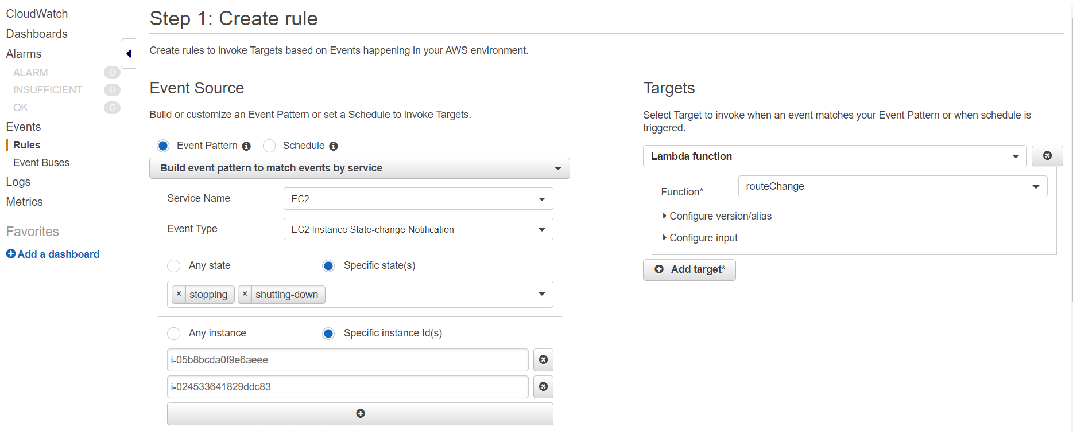
Implementation (cont)
12. Create CloudWatch rule.

Slide 22
Thank YOu

